Slide 1

Real-Time ADC Data Monitoring with I2C-LCD Display
Team Member:
1.Sanjay S K
2.Pratiksha Kale
3.Munilakshmi M

Slide 2
Introduction:
The Smart ADC Monitoring and Logging System is a real-time data acquisition project that focuses on reading analog input through an ADC (Analog-to-Digital Converter), displaying the results on an LCD, and logging the conversion data through USART communication for debugging and analysis.
The system reads an analog signal, converts it into a digital value using the onboard ADC, and displays this data on a 16x2 LCD screen. Additionally, it sends detailed logs of each conversion step through USART, allowing for remote monitoring and feedback.

Slide 3
Problem Statement:
Currently, there is a lack of a simple and integrated solution that allows easy visualization of ADC values, provides feedback on system performance, and logs data for further analysis. Most systems either focus on basic display or on data logging, without combining both in a unified setup for real-time monitoring.

Slide 4
Objective:
Reads analog values via ADC.
Displays real-time conversion results on an LCD.
Logs detailed conversion data via USART for monitoring and troubleshooting.
This system can be utilized for testing and calibration of analog circuits, monitoring voltage levels, or any application where real-time ADC data needs to be monitored, logged, and analyzed.

Slide 5
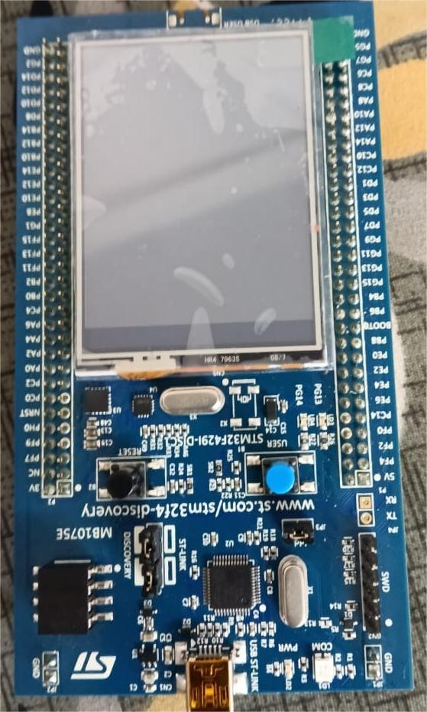
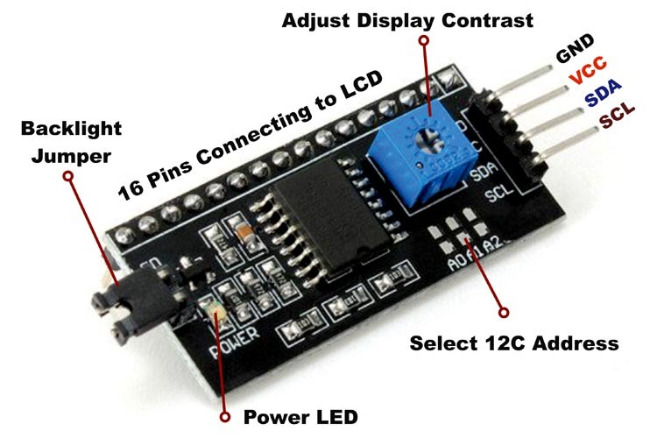
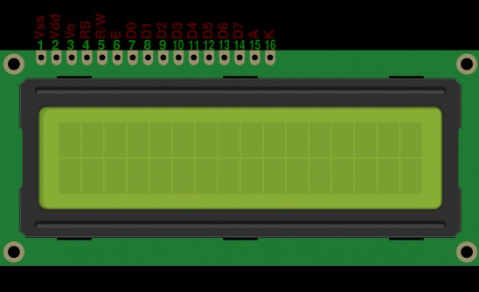
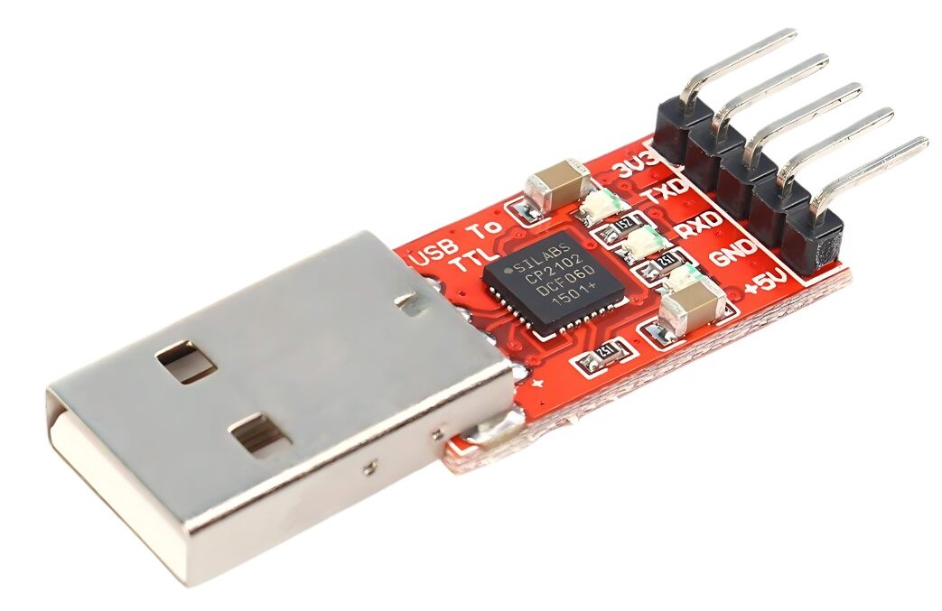
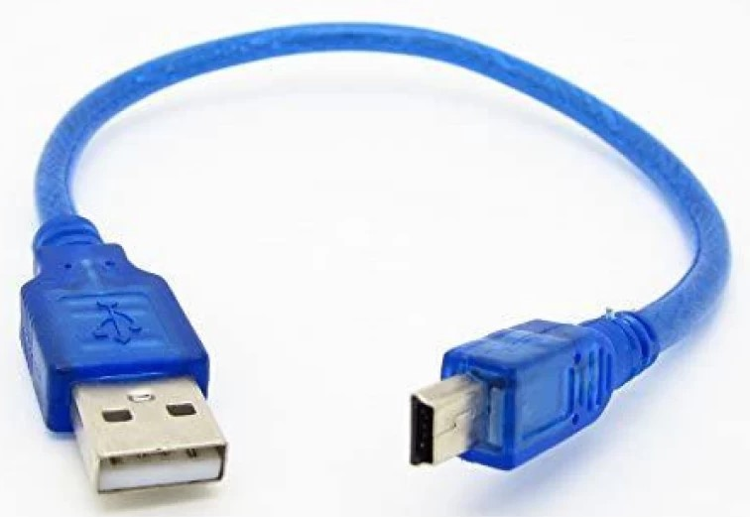
Hardware Components:
I2C(inter Integrated circuit)
LCD (16 x 2 display)
STM32F429ZIT6
USART
USB Cable

Slide 6
Hardware Description:
STM32F429ZIT6 Microcontroller: A high-performance microcontroller with a 180 MHz ARM Cortex-M4 core, used for handling ADC, LCD display, and USART communication. It provides a rich set of peripherals and processing power for real-time data processing and control.
ADC (Analog-to-Digital Converter): A built-in hardware module in the STM32F429ZIT6 that converts analog signals into corresponding digital values. It is used to sample analog inputs and process the data for display and logging.
16x2 LCD Display: A 16x2 character LCD screen used for displaying the real-time ADC values. It communicates with the STM32F429ZIT6 via I2C, providing a simple way to display data in a user-friendly format.
USART (Universal Synchronous Asynchronous Receiver Transmitter): A communication interface used for sending the ADC conversion data to a connected PC or terminal. It enables serial communication for logging the data and monitoring the system.

Slide 7
Software Requirememt
STM32 CUBE IDE
Arduino IDE

Slide 8
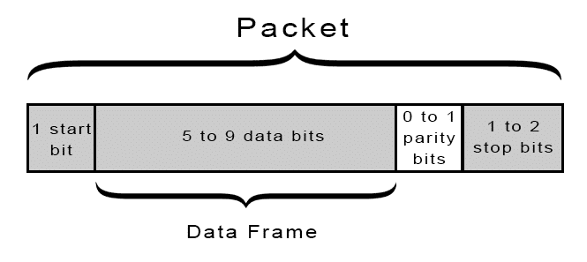
Communication Protocols
UART(UART (Universal Asynchronous Receiver/Transmitter): The UARTcommunication protocol is one of the most common serial communication systems used to enable data exchange between devices.
UART Components:
1) Transmitter (TX): Sends data from one device.
2) Receiver (RX): Receives data into another device.
UART Data Transmission:
Data is transmitted as a series of bits with a specific structure:
1.Start Bit: Signals the start of a data frame (always '0').
2.Data Bits: Typically 5 to 9 bits representing the actual data.
3.Parity Bit (optional): Used for error checking.
4.Stop Bit(s): Indicates the end of a data frame (1 or 2 bits).

Slide 9
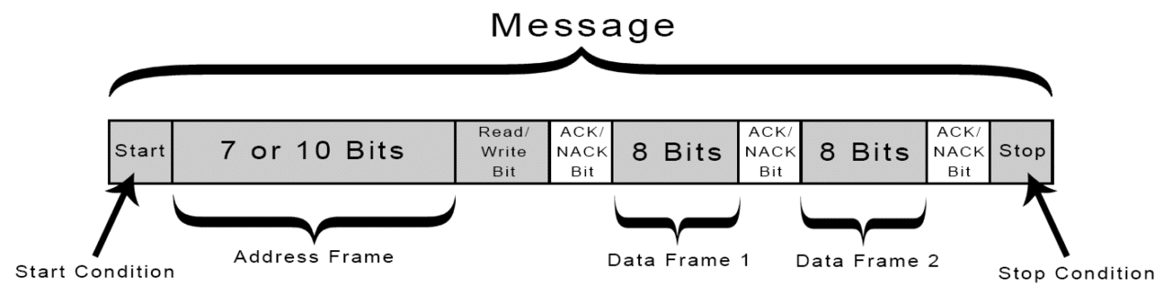
I²C (Inter-Integrated Circuit)
I²C is a synchronous serial communication protocol designed for short-distance communication between integrated circuits.it is used for communicating between microcontrollers and peripherals like sensors, LCDs.
I2C Components:
1)SDA (Serial Data Line) : Carries data.
2)SCL (Serial Clock Line): Carries the clock signal.
I²C Data Transfer Process:
1.Start Condition: The master pulls SDA low while SCL is high to signal the start of communication.
2.Address Frame: The master sends the 7-bit address of the slave, followed by a read/write bit.
3.Acknowledgment (ACK): The slave responds with an ACK bit if it recognizes its address.
4.Data Transmission: Data is sent in 8-bit frames, with an ACK bit after each frame.
5.Stop Condition: The master pulls SDA high while SCL is high to end communication.

Slide 10
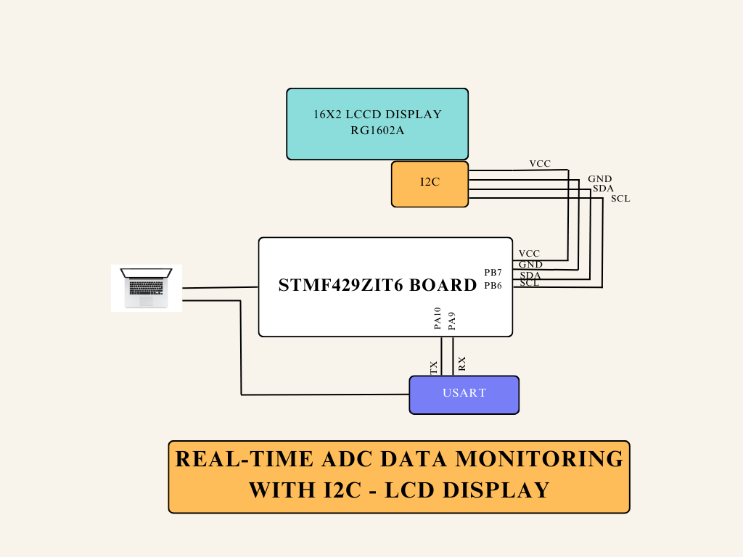
System Diagram

Slide 11
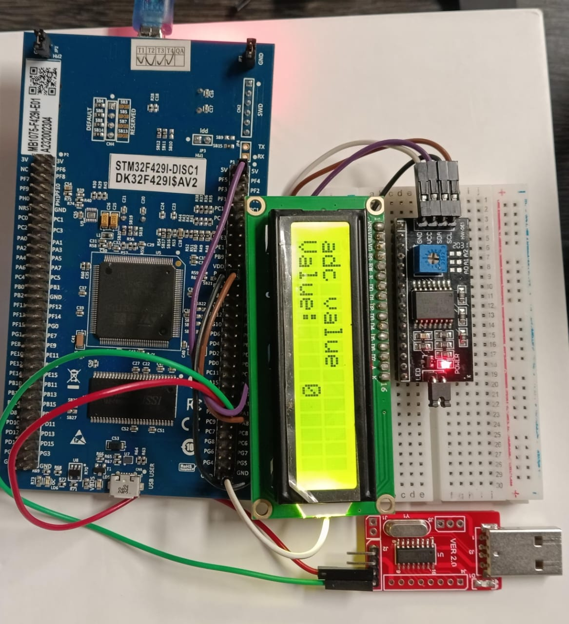
Working
1.The system continuously reads analog signals using the ADC.
2.The ADC converts these analog signals into digital values.
3.The digital values are displayed on a 16x2 LCD screen for real-time monitoring.
4.The conversion data is logged and sent via USART for further analysis or remote monitoring.

Slide 12
APPLICATION:
Testing and Calibration: Used in systems where analog signals need to be monitored and tested.
Embedded Systems Development: Provides a real-time data visualization tool for developers.
Diagnostic Tools: Helpful in troubleshooting analog circuits and systems.
IoT Systems: Can be adapted for use in IoT applications where sensor data needs to be acquired and logged.

Slide 13
Conclusion:
The Smart ADC Monitoring and Logging System successfully combines real-time data acquisition, display, and logging into a simple, efficient platform.
The system can be used for a variety of applications, including embedded system testing, analog circuit calibration, and IoT sensor monitoring.

Slide 14
THANK YOU

